Slide 1
Nyc budget spending
Group 6: Jatin Chittoor, jenny yi, Stephanie roman, roaya helal

Slide 2
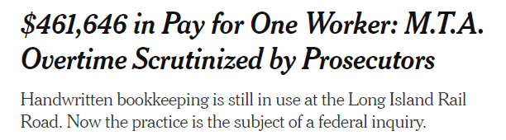
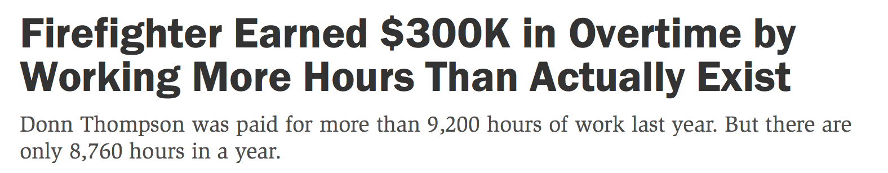
RESEARCH APPROACH
CONTEXT
A federal probe is currently looking to the MTA scandal with employees abusing over-time hours where one LIRR employee making $461,646 last year alone ($344,000 of which was from overtime, almost 3x their base salary!).
OBJECTIVES
Obtain insights into how much public New York City agencies are spending, specifically how much they’re spending on base and over-time salaries, to determine if this overtime spending issue is wide-spread or contained to a few bad apples.
Based on the objective, our research questions were:
Which public agencies have the largest budgets?
Which public agencies spend the most on base salaries? on overtime?
Among the public agencies that spend the most on base salaries and on overtime, what percentage is that of each agency’s total budget?

Slide 3

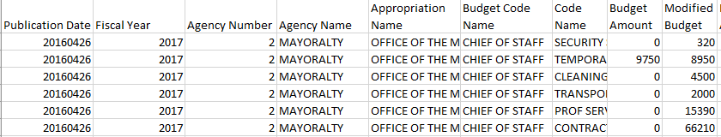
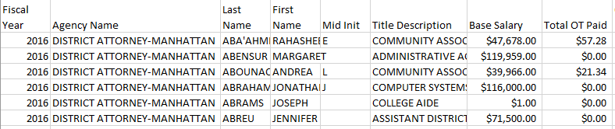
Data sources
Using publicly available data from NYC OpenData, we found two datasets:
1. Expense Budget of 292 Agencies (2017-2019), ~300K Rows
2. Citywide Payroll Information of 2,194,488 Employees (2014-2017), ~3M Rows
Notes:
Those >50YO are more likely to dislike rigid fabric and wide leg.

Slide 4
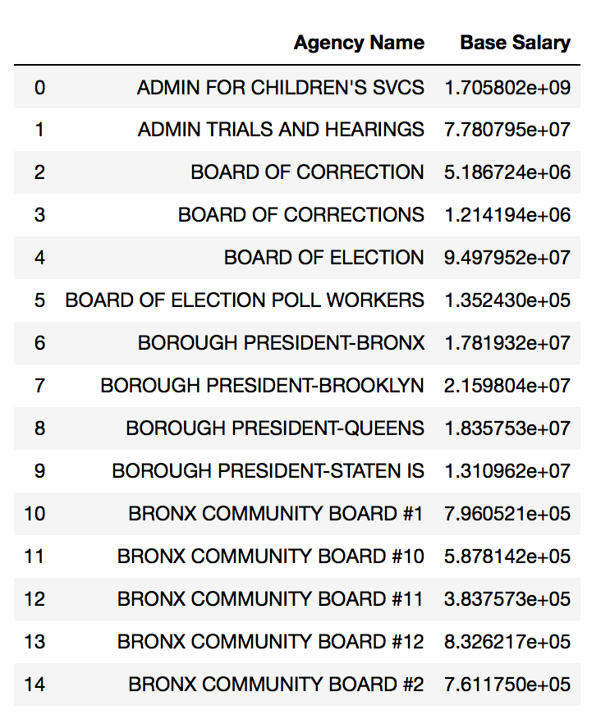
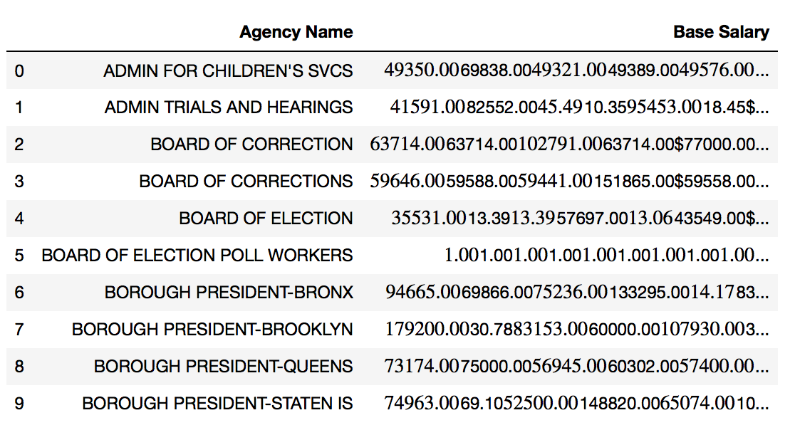
Data Cleanup & Limitations
Despite over 3 million payroll data points, we had limited corresponding data based on fiscal year and agency departments across the two sets. We also ran into a few data reformatting issues due base salaries not adding up correctly due to formatting and the same agencies being spelled slightly differently or with slightly different spacing.

Slide 5
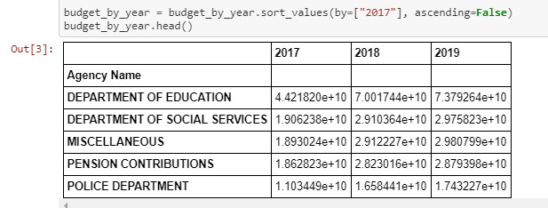
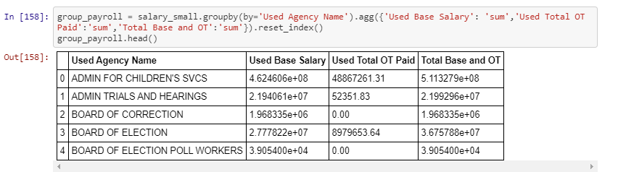
Data exploration
Once we were able to fix the reformatting and inconsistent agency naming issues, we set up our panda data frames to explore our agency and payroll data.

Slide 6
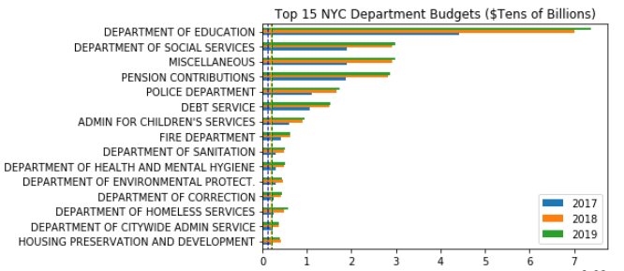
Top 15 nyc agency budgets
The Dept. Of Education has the largest budget in NYC by far. It is the largest school system in the entire country, spanning across Pre-K to 12th grade, public and charter schools, and special education programs to provide education, extracurricular activities, transportation, health services, food services, and more. We were surprised to not see the Dept. of Transportation Top 15 budgets but found out that agency is actually under the State of NY, not City funding.

Slide 7
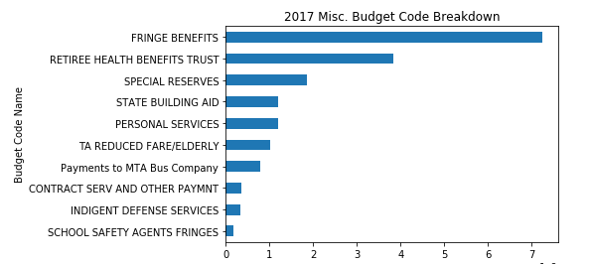
Top 15 nyc agency budgets – Misc.
Like any balance sheet, NYC agencies have a catch-all “miscellaneous” bucket to place any non-department specific costs into and avoid going over-budget within their department. This city-wide bucket is the 3rd largest budget we saw. Breaking down the 2017 miscellaneous budget, we saw that most of the funds were fringe benefits.
Fringe Benefits are any type of non-salary income like medical insurance, vacation pay, meals, tuition reimbursement, etc.

Slide 8
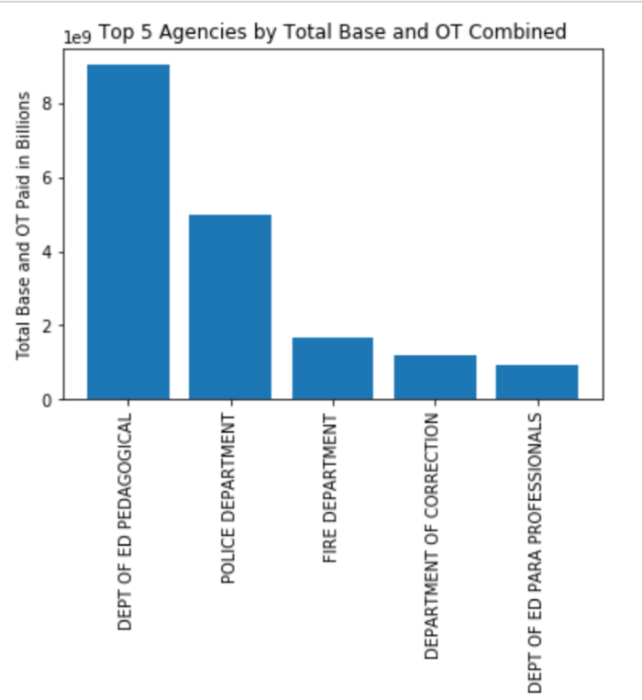
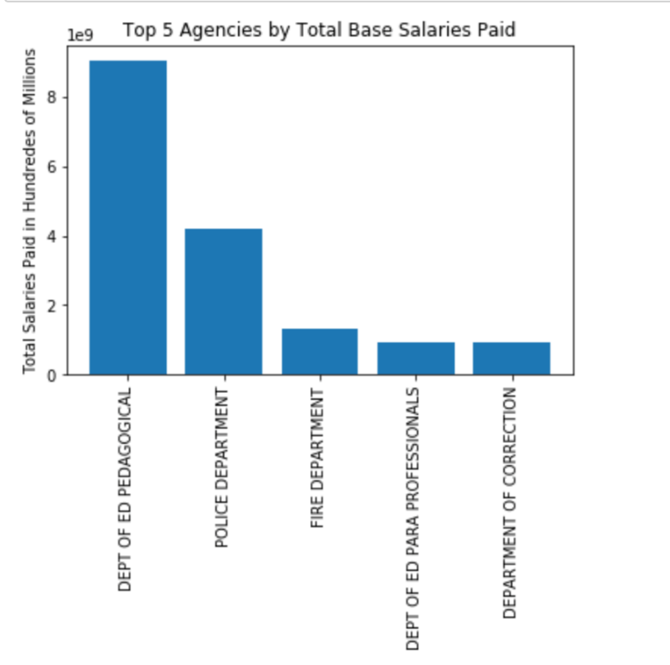
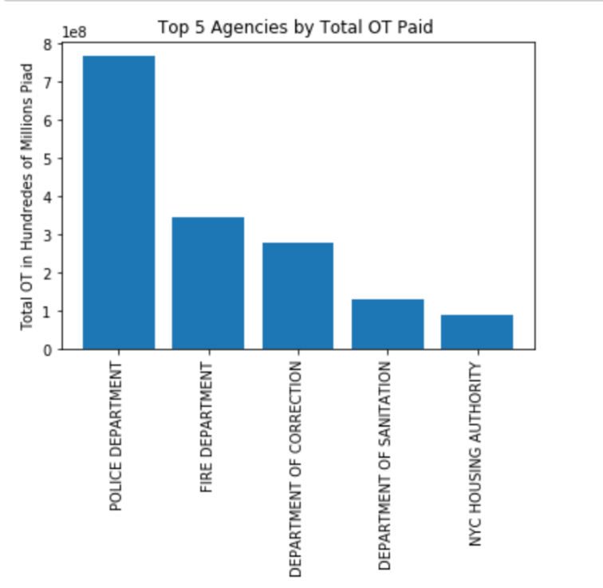
Top 5 spend on total, base, overtime salary
Among the top 5 agencies with the largest total salaries, two are part of the department of education and the other 3 are the police dept., fire dept., and dept. of corrections. When looking solely at overtime pay, the police dept., fire dept., and dept. of corrections jump up to the top 3 agency slots.

Slide 9
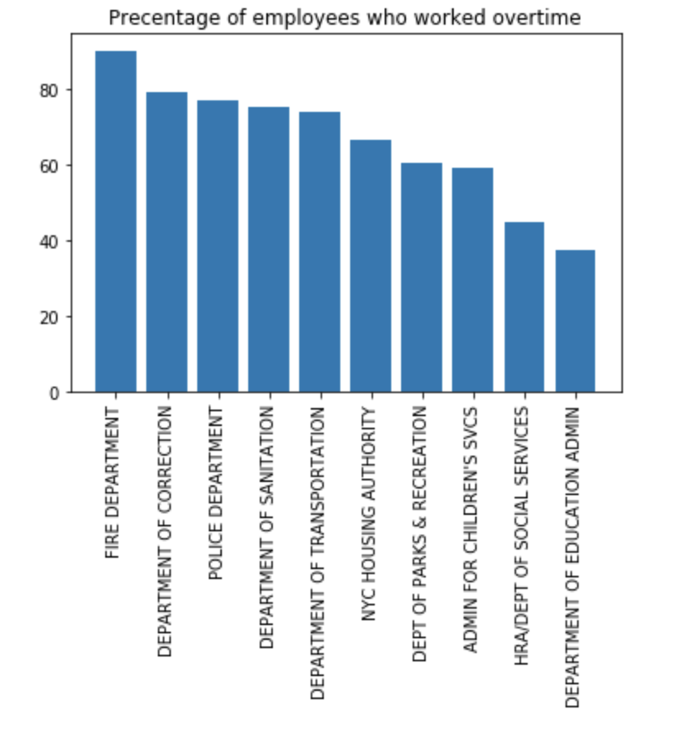
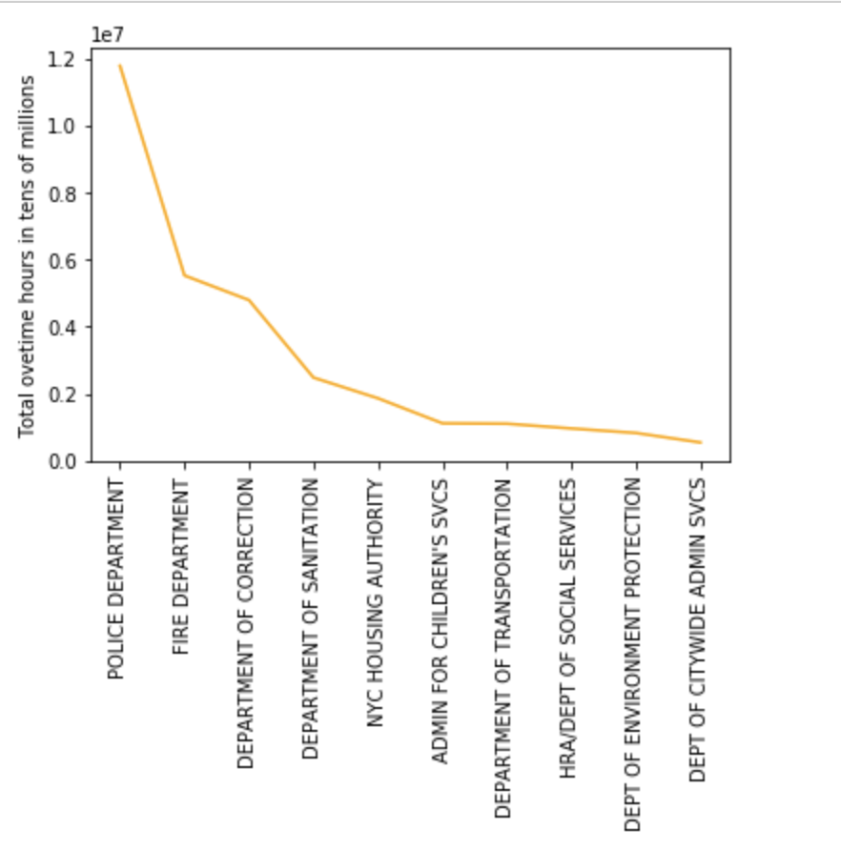
Overtime pay by % of Total employees & Hours
The same top 5 agencies with the largest OT spend also have the highest percentage of employees working overtime. An employee in the police department is expected to make 248.54% more than their base salary just through overtime.

Slide 10
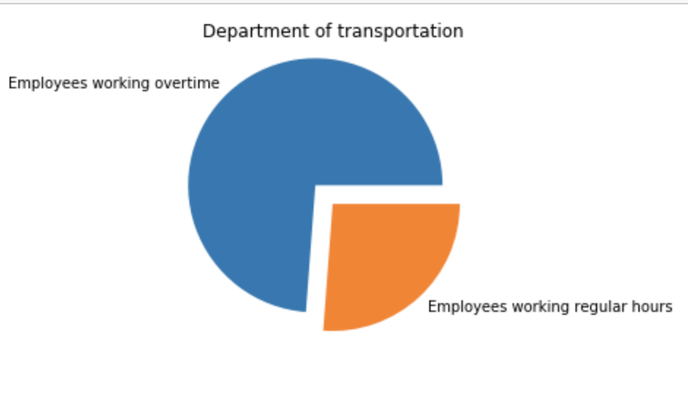
Overtime pay by Dept. Of Trans.
The same top 5 agencies with the largest OT spend also have the highest percentage of employees working overtime. Interestingly, the dept. of transportation has the 5th largest percentage of their employees clocking in OT (!) A dept. of transportation employee is expected to make %14.54 more than their base salary by doing overtime.

Slide 11
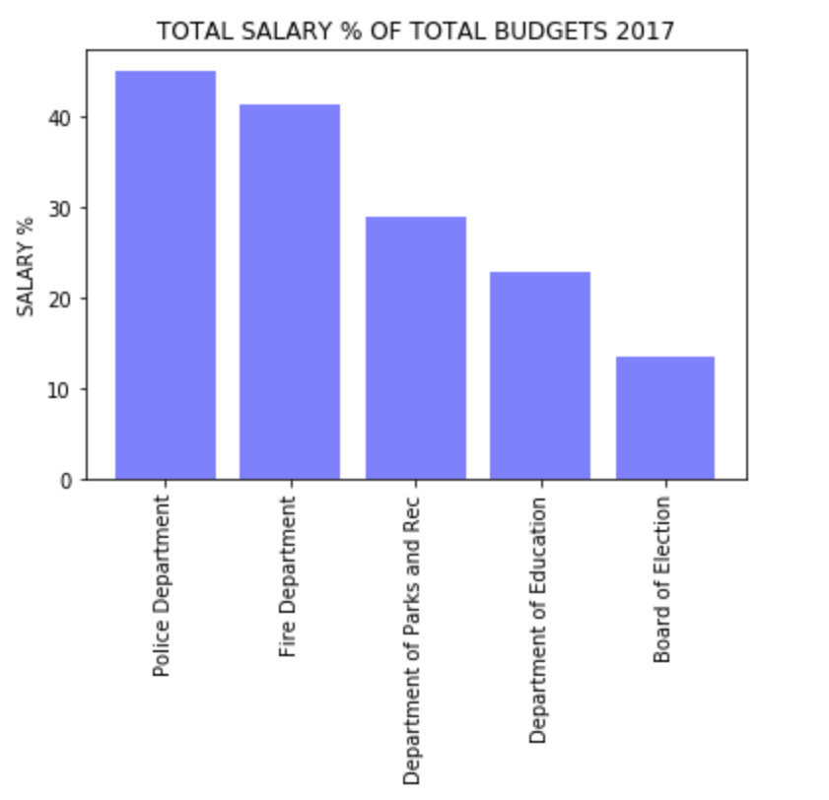
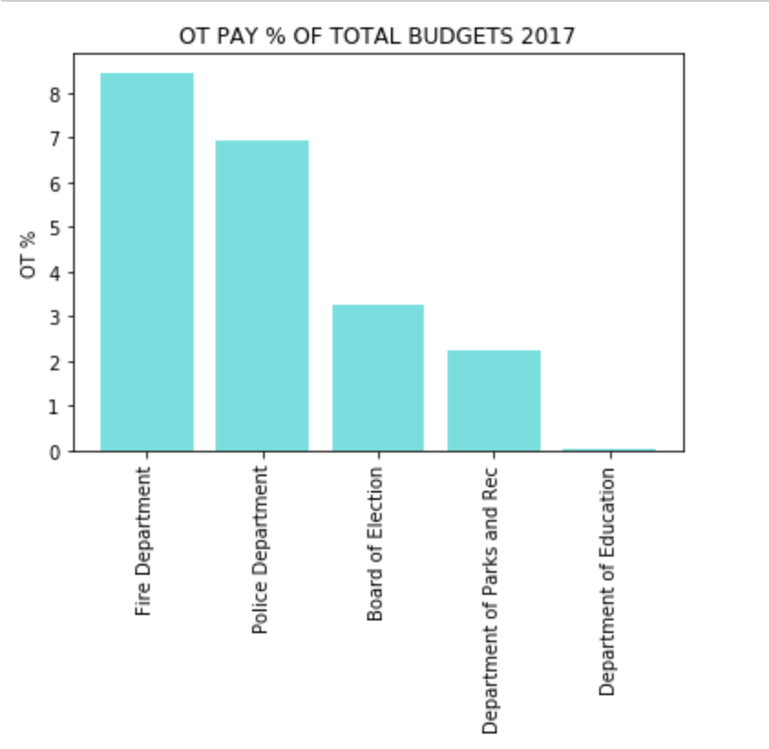
salary to total budget breakout
Based on OT pay spending and the percentage of that OT by total budget (below), we can conclude that OT spending is not a wide-spread issue among NYC public agencies, it’s more on a few bad apples, specifically the police dept. who spends the largest percentage of their budget (5th largest) on salaries and fire dept. who spends the second most (8th largest).
Notes:
**Add note on education overtime

Slide 12
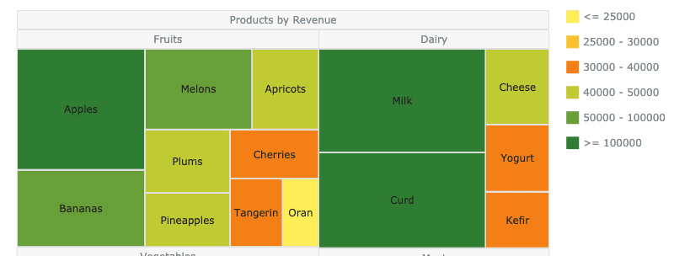
Post mortem – WOULD’VE, COULD’VE, SHOULD’VE
WOULD’VE
If we had more time, we would have looked into the additional “Total Other Pay” column in the Payroll data file and we would have done some cooler charts like this one:
COULD’VE
We could’ve looked at gender salary gaps if gender was available it the payroll data. We could’ve looked at base salary differences across agencies for the same role. (e.g. how much does a data analyst make at one agency vs. another?)
SHOULD’VE
We should’ve cleaned the data more because within the >3.3million rows there were some hourly wage employees included in base salary but we’re confident this subset would not have significantly impacted the results.

Slide 13
Questions?

Slide 14
Thank you!

